Slide 1
Adam’s Section
CS106A - Code in Place 2023

Slide 2

Welcome and congratulations!

Slide 3



What is an online Section?
A more intimate, one-on-one environment for you to get a recap of this week’s content, ask any questions, and work through an example together!

Slide 4


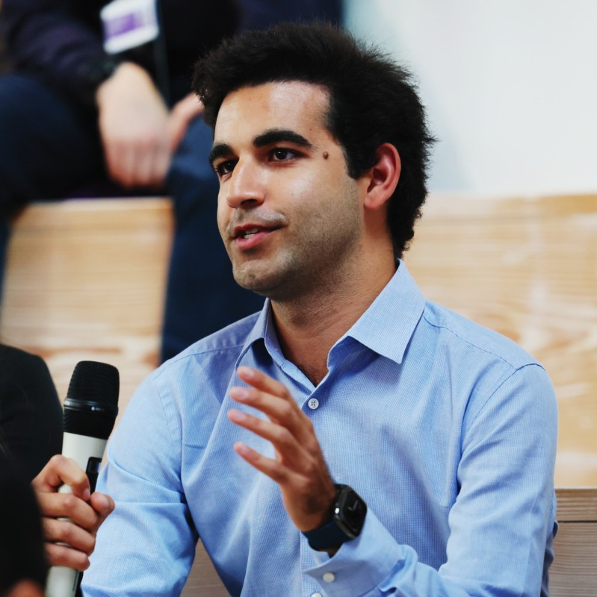


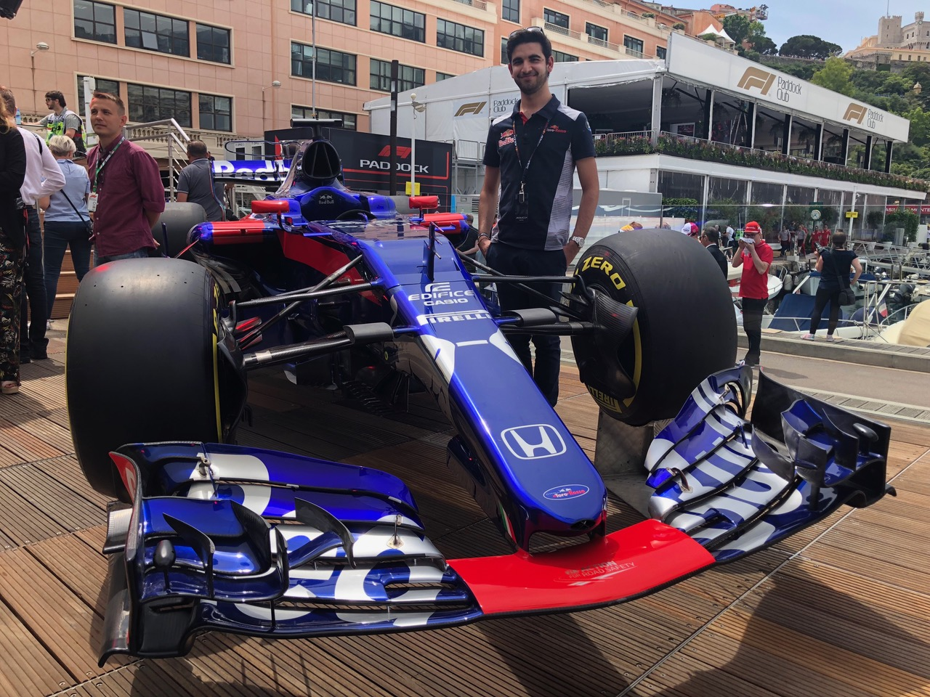
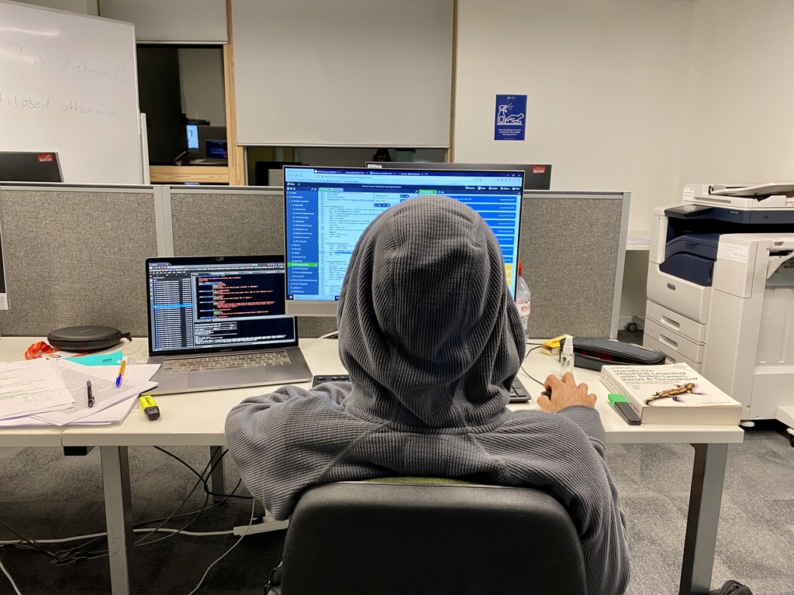
A little bit about me
BSc
Computer Science
Master’s
Artificial Intelligence
University of Bath
Grew up in 🇲🇨
Originally from 🇬🇧 🇮🇹 🇨🇦

Slide 5
A little about you!
📣 Introduce yourself
🌍 Where in the world you are right
now
💼 What you do in life
🤗 Why are you excited about Code
in Place?
🤩 1 interesting fact about you!
🗣️ Name someone else to introduce
themselves

Slide 6
Core Values
Interactivity and Engagement
Section != lecture
Section is about collaborating on code and building a community.
There’s no one right answer
Mistakes are a good thing!
Ask Ask Ask!
Respect
Open-Mindedness and Patience
FUN
Notes:
I’m not here to judge if you didn’t watch lecture. Come to section even if you didn’t watch. Come to section *especially* if you didn’t watch

Slide 7
Course Logistics & Communication
Section is the same time every Friday for 6 weeks
I will join the sections 5 minutes before and stay 15 minutes after for any questions
Use our Section’s forum to ask me or your section members any questions (about the exercises, the lectures, or to start interesting conversations
Please mute your mics when you join (for minimum background noise) and minimize any distractions for you (close those tabs!)
Feel free to unmute at any time to stop me and ask anything!
If you’re comfortable, keep cameras on so we can all see each other!

Slide 8

Code in Place
Section 1: Welcome to Section
Week 1: April 28th, 2023

Slide 9
Where We Are
Course Logistics
Getting to know each other
Review concepts
Work through a problem together

Slide 10
Learning Goals
How to approach a problem?
Recapping decomposition and loops
Defining helper functions
If statements
Practicing loops
How to decide between a while and a for loop

Slide 11
Approaching a problem
Understand | Strategise | Translate
Write stuff down. Explain problem out loud to someone. Draw a picture. | Walk through an example or two. Look for patterns. Think about what things you’ll need: loops, conditions, helper functions, etc. | First into pseudocode. Then into Python.

Slide 12
Concept Review
Decomposition
While vs. For Loop
If Statements

Slide 13
Decomposition
Break a problem into smaller problems that are more manageable to solve to repetition and code getting too long/complex.
More of an art than a science.
Functions should be short and read like English.
If you repeat things (or find yourself hitting copy/paste), take a step back.

Slide 14
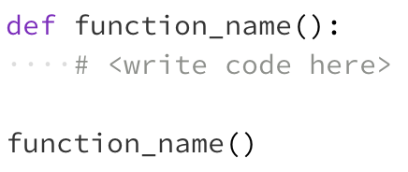
Decomposition
How:
Pre/post conditions: each helper function defines a contract (Karel should end in the same state that it started in)
Define your function like this
Call/use function like this

Slide 15
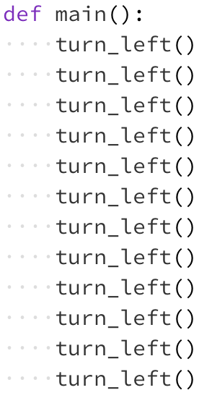
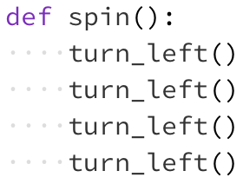
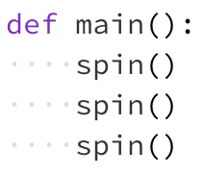
Decomposition
Example:
Notes:
Does this code do the same thing?
Is this code easier to read/understand?
Is this code easier to write?

Slide 16
Decomposition
Key takeaway: making each function have a single responsibility

Slide 17
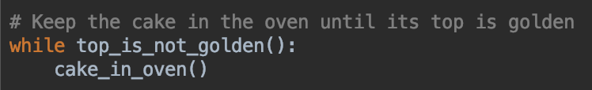
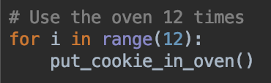
Control flow: While vs. For Loops
You’re baking at home, and you don’t know how long the cake should stay in the oven. All you know is that you should keep it in the oven until the top is golden.
While Loop
You’re baking some cookies but the oven is only big enough to hold one cookie at a time. You have 12 cookies so you know that you need to use the oven 12 times.
For Loop

Slide 18
Control flow: While vs. For Loops
While Loop:
When you aren’t sure the exact number of times the loop should iterate
We weren’t sure how many minutes we needed before the cake was ready
For Loop:
When you know the exact number of times the loop should iterate
We knew we needed to put exactly 12 cookies in the oven

Slide 19
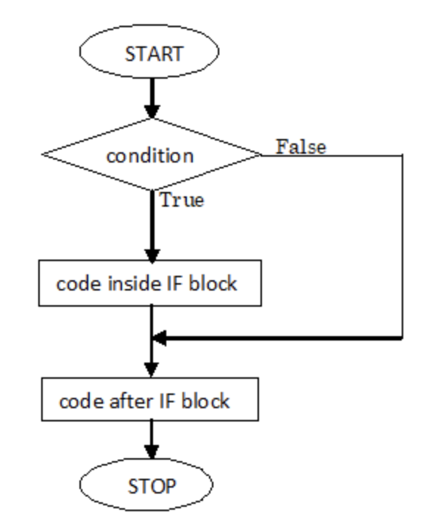
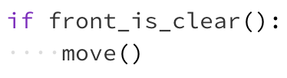
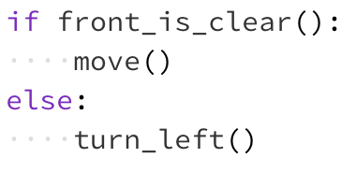
Control flow: If/Else statements
Also called branching
Making decisions based on conditions
If
If/Else
Do something if a condition is met:
Also do something else when a condition is not met:

Slide 20

Let’s get some practice together!
Karel Hospital Problem

Slide 21
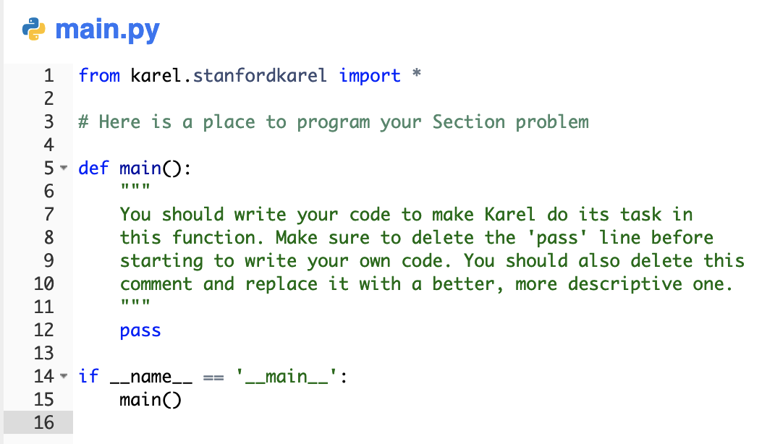
Skeleton Code
The outer structure of the code with no functionality
Similar across different programs

Slide 22
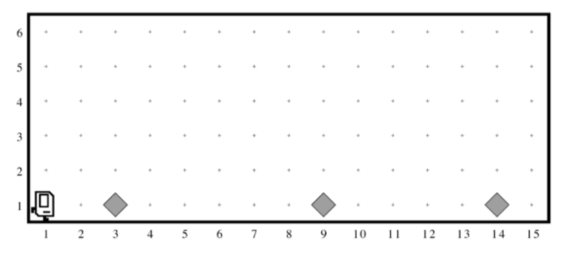
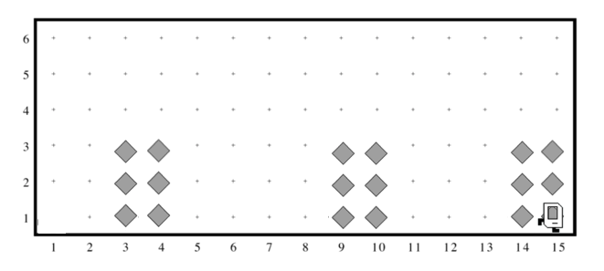
Hospital Karel

Slide 23

Wrap Up Announcements
Section forum: Post on the forum so that everyone can learn together!
Something I did well, something I can do better?
Meeting next week, same time and same link!

Slide 24
See you next week!
Section 1: Karel the Robot

